Slide 1
Discussion today
Using Lumerical INTERCONNECT we will simulate a full 50Gbps (25Gbps X 2) 2-channel WDM optical link.
Today we will look at the following:
Discuss ring resonator in INTERCONNECT
Import MODE results of effective index as a function carrier density into INTERCONNECT
Design and draw schematic of WDM optical link
Analyze results using eye-diagram

Slide 2
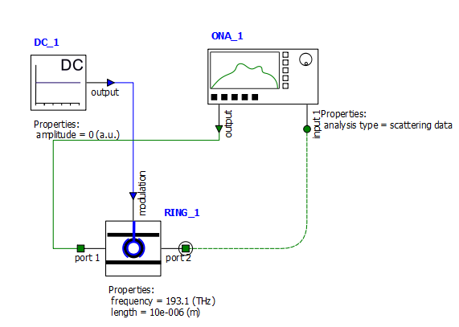
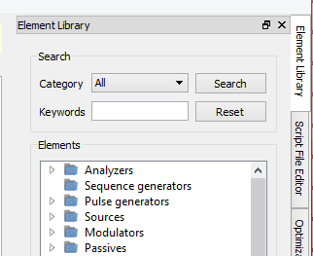
Analyzing ring resonator modulator in INTERCONNECT
Create the following circuit in INTERCONNECT consisting of
DC source (Sources→Electrical→DC Source)
Optical Network Analyzer (Analyzers→Optical→Optical Network Analyzer)
Ring Modulator (Modulators→Optical→Optical Ring Modulator)
Click and drag to draw connections

Slide 3
Ring resonator modulator model in INTERCONNECT
Select ring resonator object and change in Property View:
Standard $→$
Specify frequency of 193.1 THz
Specify length of 60e-6 m
Set load from file to True
Select measurement filename and set to mod_neff_V.dat (data of $Δn_{eff}$ vs. V - created in MODE last time)
Waveguide $→$
Specify group index 2.57 (from MODE)
Set loss to 7 dB/m (from last time we had ~0.07 dB/cm loss in simulation)
Set effective index to 0 (think of this as change in effective index)
Set coupling coefficient 1 and 2 to 0.025

Slide 4
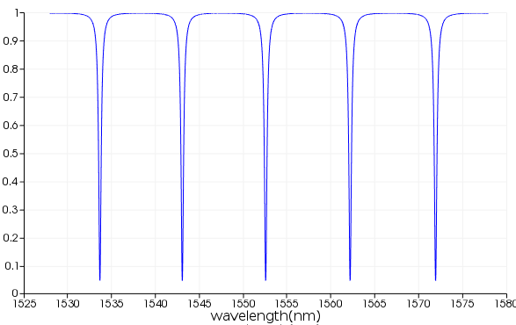
Ring resonator modulator model in INTERCONNECT
The ring resonator modulator model in INTERCONNECT is not documented very well.
The resonator length and group index is used to set the free spectral range (FSR) and loss of the ring resonator but not used to set the absolute resonance frequencies.
Instead we explicitly state what the resonance frequency should be.
$$FSR=\frac{λ^{2}}{n_{g}L}$$
(recall $Δf=\frac{c}{n_{g}L}$, and $\frac{Δf}{f}=\frac{Δλ}{λ}$)
FSR
$$n_{g}=n_{eff}+f_{0}\frac{∂n_{eff}}{∂f}$$
(proof: take $d/dω$ of $k=\frac{ω}{c}n_{eff}(ω)$)

Slide 5
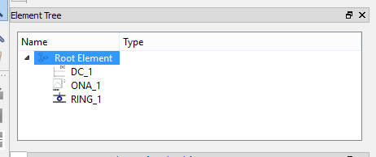
Effect of voltage on transmission spectrum
Click Root Element in Element Tree
Set Simulation $→$ sample rate to 1e11 Hz (otherwise will give an error)
Run simulation to populate Result View

Slide 6
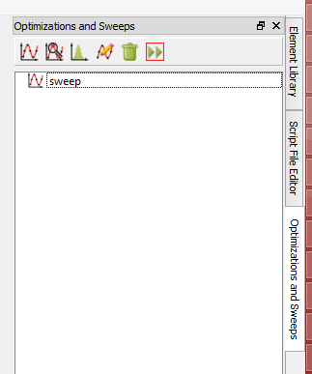
Effect of voltage on transmission spectrum
Create a sweep to vary the reverse bias voltage between 0 and 3V
Right click, Edit

Slide 7
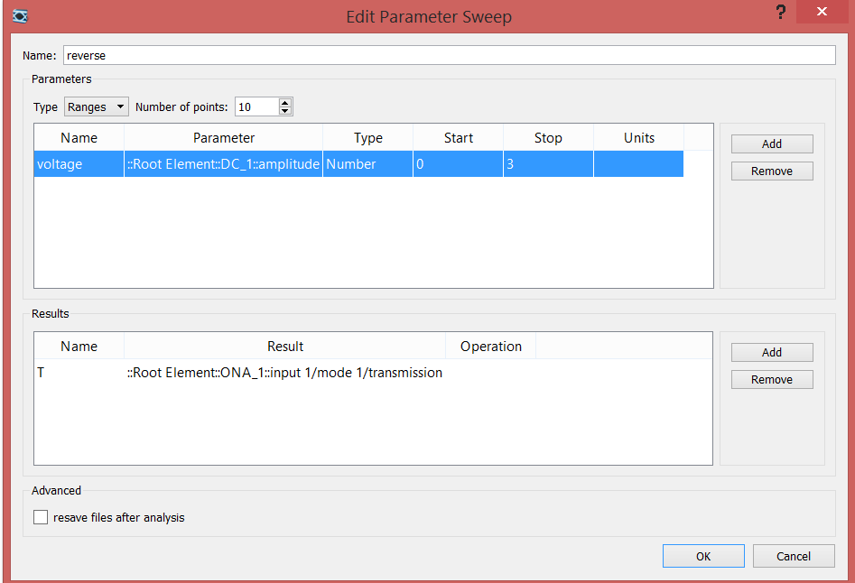
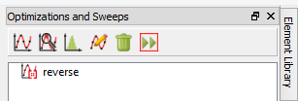
Run sweep.
Plot Transmission data (Right-click reverse, Visualize→T)

Slide 8
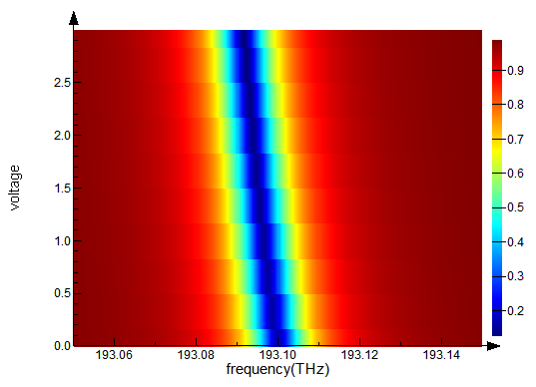
Effect of voltage on transmission spectrum
(click Scalar operation -> Abs)
With applied voltage, the transmission dip shifts away from the center frequency

Slide 9
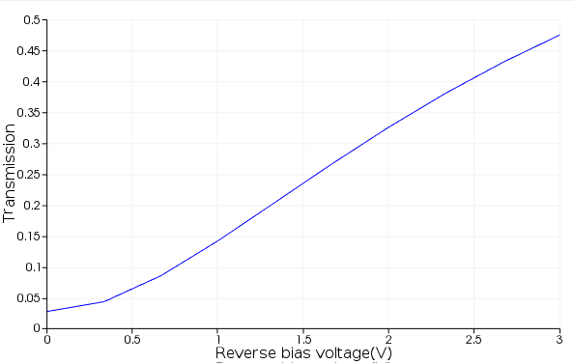
Effect of voltage on transmission spectrum
Open the script plot_ring_modulator_data.lsf (drag into simulation window), and run it
Plots the transmission at the center frequency as a function of applied voltage.

Slide 10
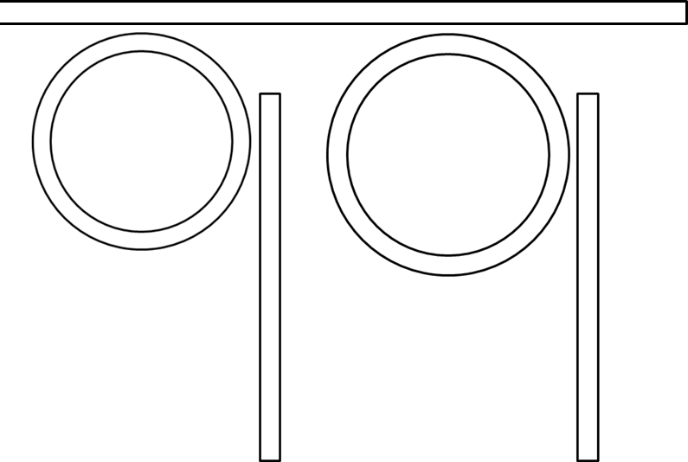
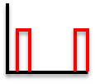
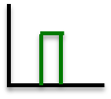
50GBps (2x25GBps) 2-channel WDM
Transmitter
fiber
Receiver
$$λ_{1}$$
$$λ_{2}$$
$$λ_{1}$$
$$λ_{2}$$
CW lasers
$$λ_{1}$$
$$λ_{2}$$
Data in (25GBps per channel)
Det.
Det.
Data out
$λ_{1}$=1552.8 nm
(200 GHz channel spacing)
$λ_{2}$= 1551.2 nm

Slide 11
50GBps (2x25GBps) 2-channel WDM
Open the INTERCONNECT file 2_channel_WDM.icp
This schematic contains a full 2-channel optical link consisting of 2 ring resonator modulators at the transmitter and 2 ring resonator filters at the receiver.

Slide 12
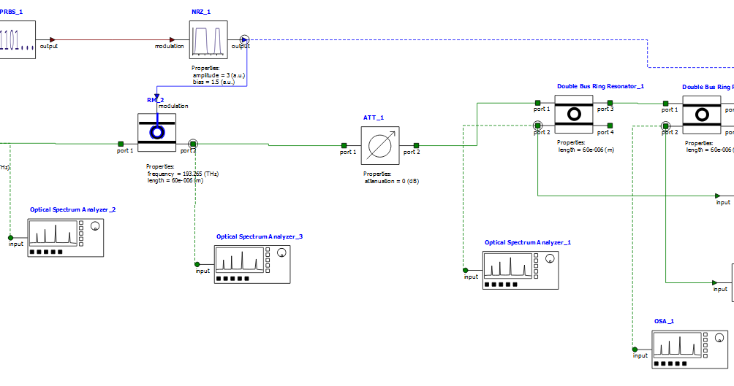
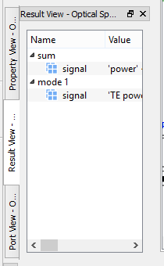
50GBps (2x25GBps) 2-channel WDM
Click Run
Plot the power at the Optical Spectrum Analyzer after each ring resonator modulator (select object, in Result View right click mode 1→signal and Visualize)

Slide 13
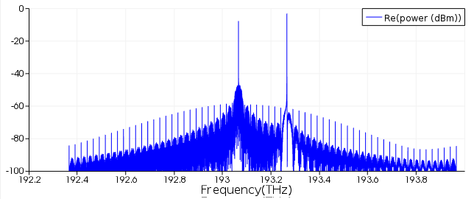
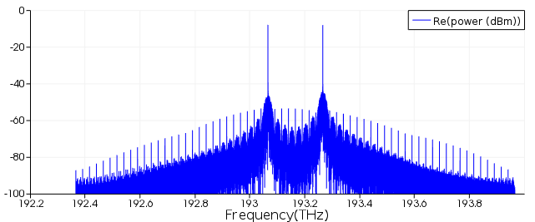
Power shifted to sidebands
After 193.065 THz modulator
FT
Recall: $f\left(t\right)⋅g\left(t\right)→F\left(ω\right)∗G(ω)$
After 193.265 THz modulator

Slide 14
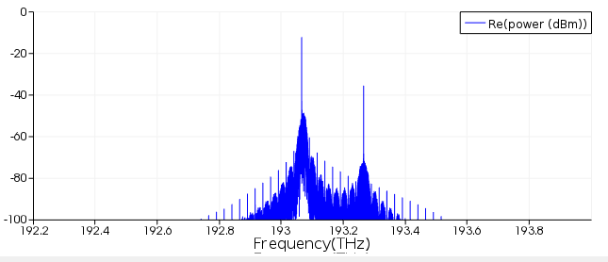
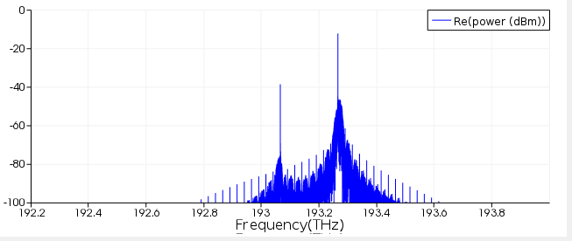
After 193.065 THz filter
After 193.265 THz filter

Slide 15
Non-return to zero (NRZ) vs. return to zero (RZ)
RZ signal
Time
NRZ signal
0
1
0
1
1
Time

Slide 16
Non-return to zero (NRZ) vs. return to zero (RZ)
RZ requires twice as much bandwidth as NRZ
One advantage of RZ is less interference between successive pulses
http://www.keysight.com/upload/cmc_upload/All/SLDPRE_6_Return_Zero_Methodo.pdf

Slide 17
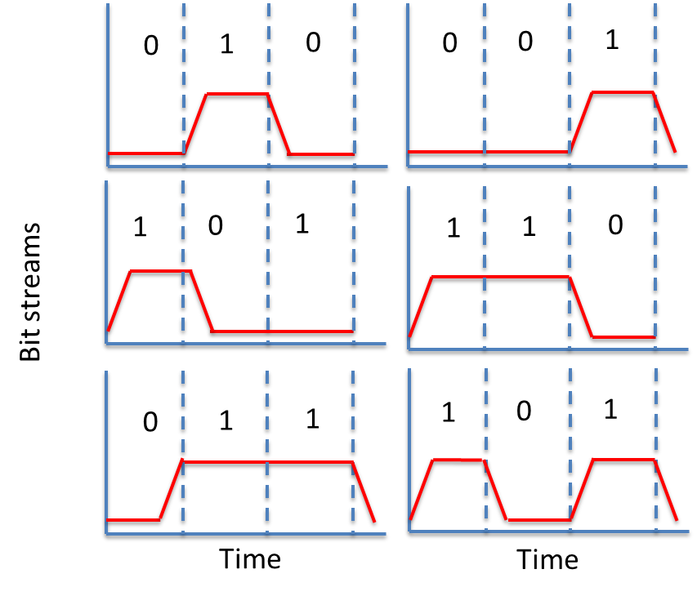
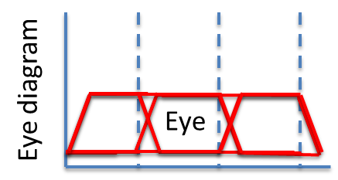
Eye diagram
Superimpose the oscilloscope trace of many different bit streams on top of each other. If there is good margin between “1” and “0” you should see something like a human eye.
etc.

Slide 18
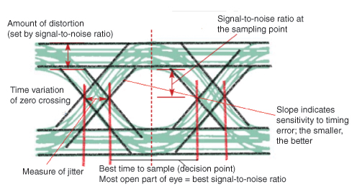
Eye diagram
SNR can be used to estimate bit-error rate (BER), given some distribution of noise (typically Gaussian)
Source: edn.com

Slide 19
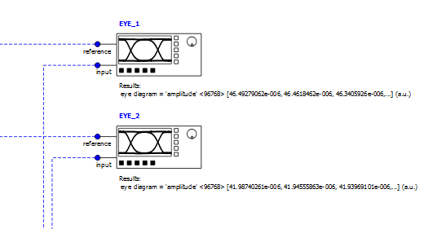
50GBps (2x25GBps) 2-channel WDM
Plot the result of the eye diagram monitors on the far right
Select object, Result View, right click eye diagram and Visualize

Slide 20
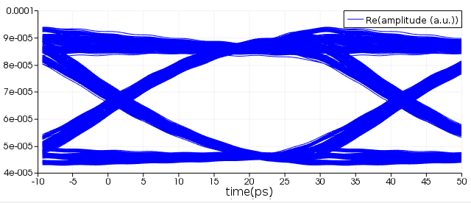
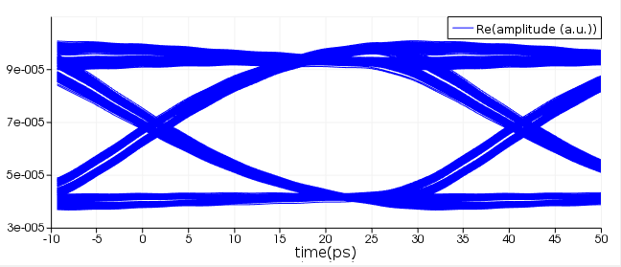
193.065 THz eye
193.265 THz
eye
Very good “eyes” since no noise included

